Slide 1



GAMES
Notes:
Good Afternoon ,everyone! Firstly, I wanna to say it’s my honor to stand on this place to present my speech-the games. And then, I’ll be say sorry to someone who do not paly games, after all i can’t satisfy everyone. So I choose to forget these details, just go heard.

Slide 2
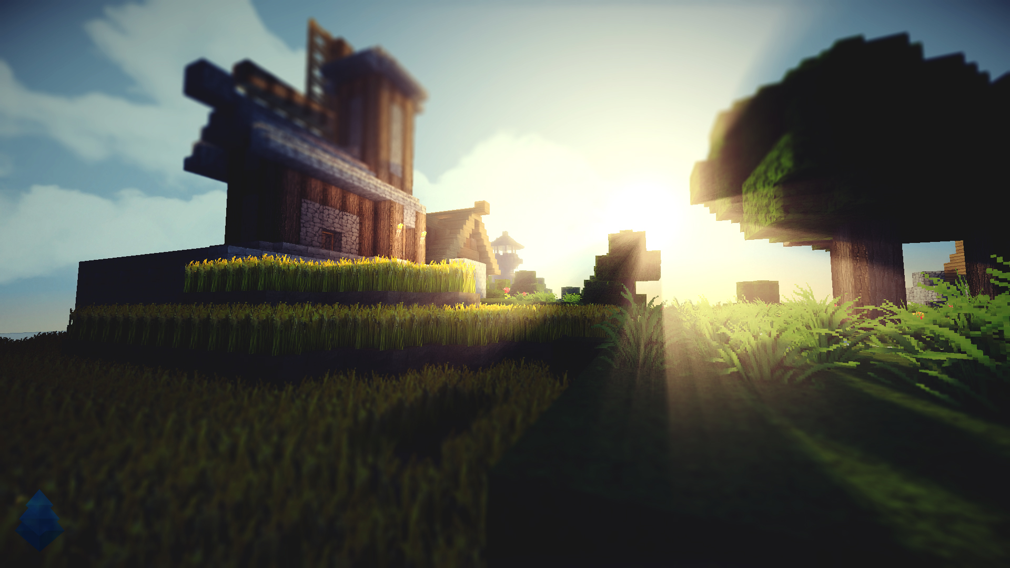
GAMES
RPG
ACT
MOBA
PUZ
…
Notes:
Games can be classified at a different angle.
Stand on a formal point :
RPG(Blade & Soul),
ACT(Dishonored),
MOBA-Multiplayer Online Battle Arena Games(League of Legends)
PUZ:minecraft. And so on.
And games can be divided into online and offline.
I would like to recognize them with free or not free.
游戏分类：RPG。。
网络/单机游戏
手游/pc
花钱和不花钱。

Slide 3
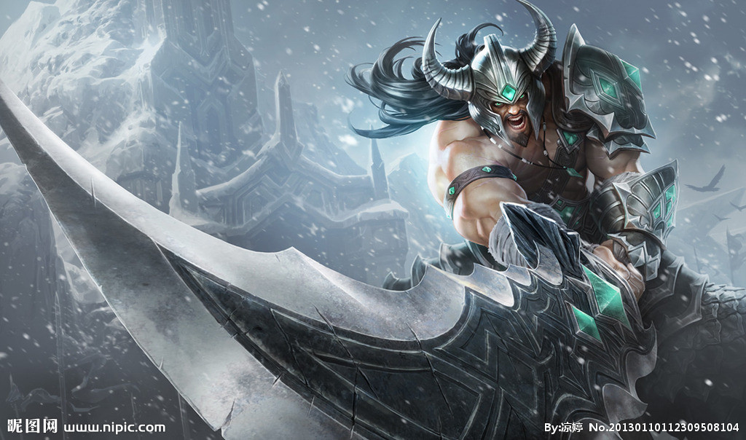
These audios can be played for a year!
Notes:
网络游戏：lol
Adc apc tank miss assassin jungle support gank ward
蛮王：Tryndamere slaughter
寒冰：Ashe
猴子：MonkeyKing
盖伦：Garen
剑圣：MasterYi
小炮：Tristana
这音频我能玩一年

Slide 4
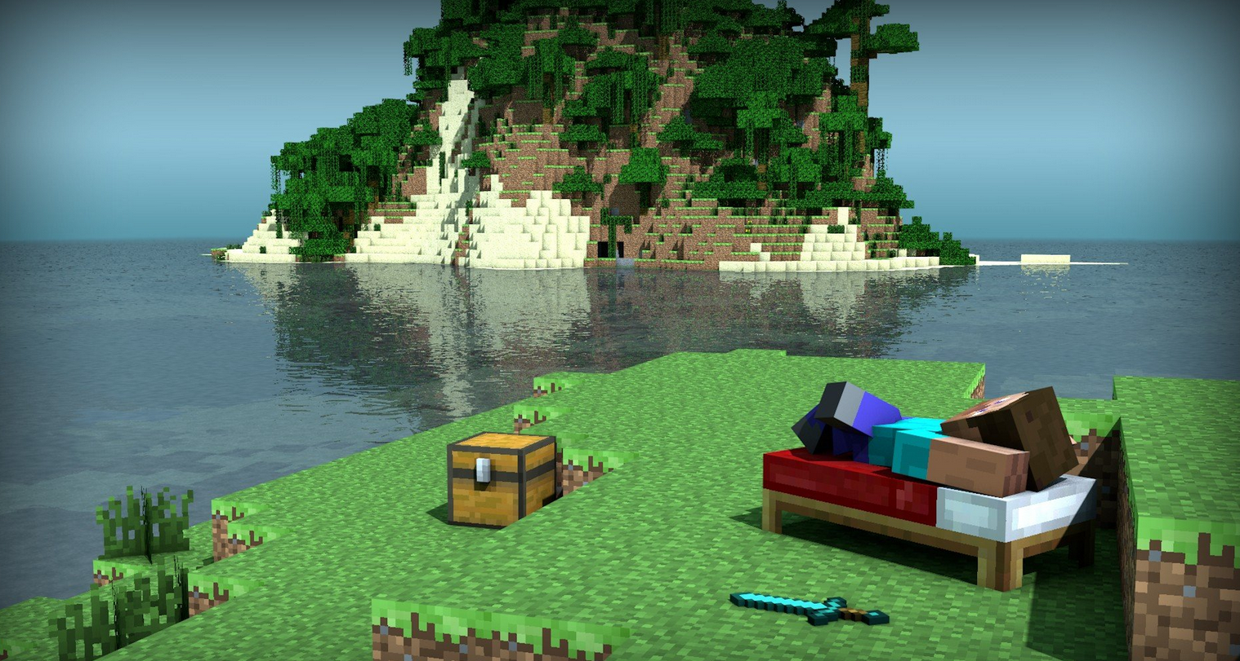
Notes:
Minecraft, a very famous game. it is a creation and sandbox game, player can create anything u want, it’s very interesting . Recommend with both feet. In a real world, u can’t afford a house, in this game, yes , u can get it easily. Make it simple like this? 简易or奢华

Slide 5
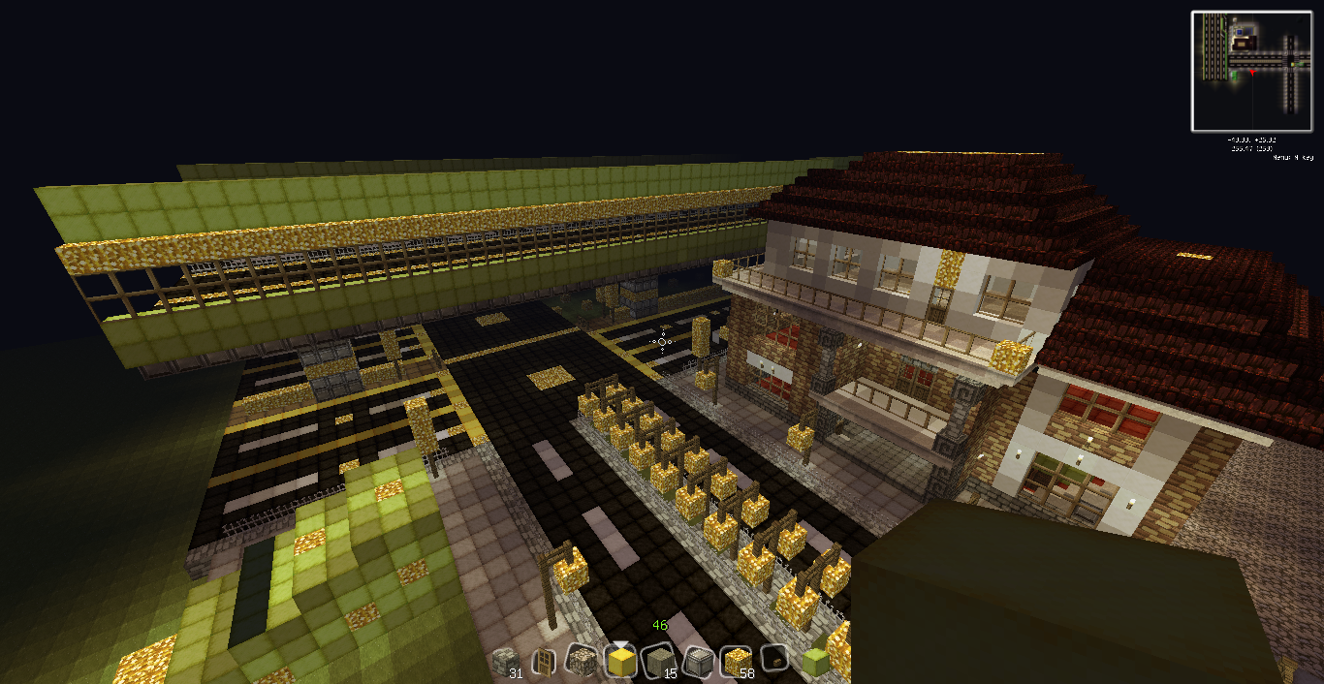
Notes:
Or luxurious,it’s up to u.

Slide 6
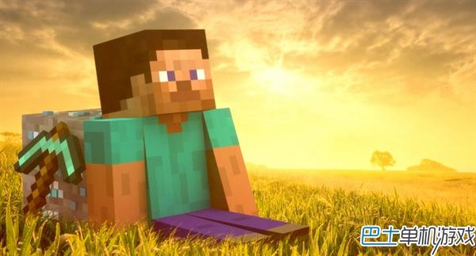
Thanks

